Slide 1
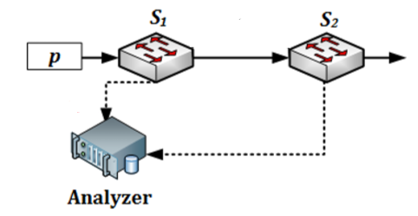
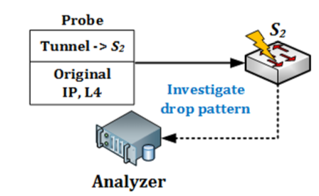
A brief introduction to Everflow
1. Rule match
2. Collection of mirrored packets.
Match and Mirror
Guided Probing
Everflow is a tool to collect and analyze packet-level traffic trace for network troubleshooting.
Match and Mirror: install a set of match rules in the switches to capture the interested packets (including control packets such as BGP, PFC and RDMA);
Guided Probing: inject any desired packets into any desired switches and trace the behavior of the injected packet.
In addition, Everflow will also collect some aggregated trace like link load and link latency.

Slide 2
API of Everflow
GetTrace(Filter, Condition, StartTime, EndTime) is used to get the packet traces between StartTime and EndTime.
GetCounter(Name, StartTime, EndTime) is used to retrieve the counter values between StartTime and EndTime. Each counter is identiﬁed by a descriptive Name, such as “SwitchX_PortY_TCP”.
AddCounter(Name, Filter) & RemoveCounter(Name) are used to dynamically add or remove ﬁne-grained load counters.
Probe(Format, Interval, Count) is used to launch guided probes.
EnableDbg(Servers, Filter) & DisableDbg(Servers, Filter) are used to mark or unmark packets with the debug bit on certain servers.

Slide 3
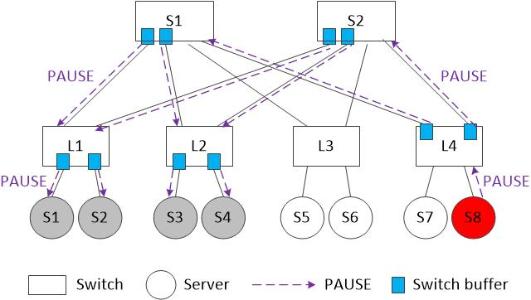
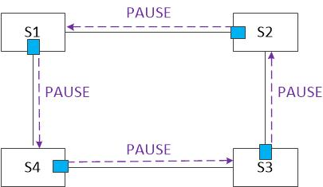
Two observations about mad NIC and deadlock problems
Mad NIC problem: server S8 has a mad NIC spewing PAUSEs for no reason.
Deadlock problem
Observation 1: when mad NIC or deadlock occurs, 1) switch ports send PAUSEs without sending RESUMEs later to recover the links or 2) the number of PAUSEs is much more than the number of RESUMEs.
Observation 2: For mad NIC scenario, the PAUSEs form a spanning tree without loop; For deadlock scenario, the PAUSEs form a loop.

Slide 4
Detect mad NIC and deadlock with Everflow
Once a switch port 1) sends PAUSEs without RESUMEs following up, or 2) sends much more PAUSEs than RESUMEs in a time T (T is a time threshold set in advance), we mark the associated link as a suspected link with a direction.
Based on the graph formed by the suspected links, we can distinguish mad NIC scenario from deadlock scenario by searching a loop in the graph.

Slide 5
Reproduce mad NIC and deadlock with Everflow
If we can configure the switches as well as the server NICs, the reproduction is quite easy: to create mad NIC, we can set a small PFC threshold; for deadlock, we install some forwarding rules to form a routing loop.
Without access to the hardware, is it possible that to leverage the guided probe function of Everflow to send some fake PFC messages to the desired switches?

